Slide 1
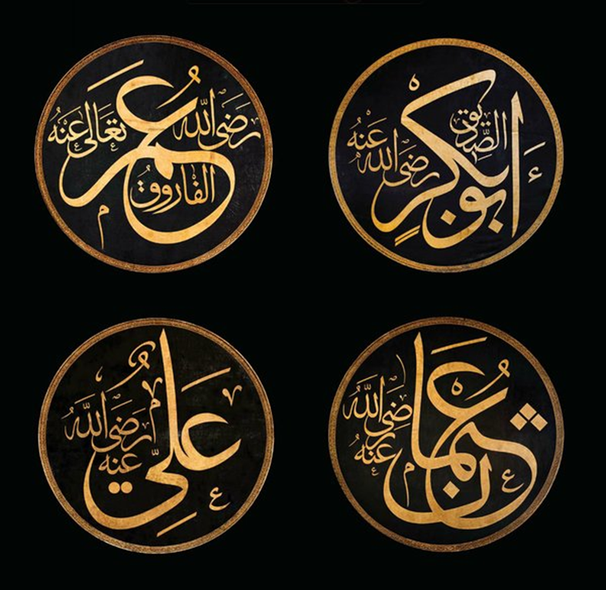
KHULFA-E-RASHIDEEN

Slide 2
THE GUIDED KHILAFAT
HAZRAT ABU BAKAR <RA>
HAZRAT UMAR FAROOQ <RA>
HAZRAT USMAN GHANI <RA>
HAZRAT ALI <RA>

Slide 3
HAZRAT ABU BAKAR <RA>
BORN ---572 A.D Mecca
His name was ABDULLAH
Father: Abu Qahafah
Mother: Ummul Khair Salma
Wealthy merchant
Close friend of holy prophet
Title: siddiq
Accompanied the holy prophet saw during his migration from mecca to madina
Passed away on AUGUST 23,634 AD
He was khalifa for 2 years

Slide 4
HAZRAT UMAR <RA>
TITLE: IBN AL-KHATTAB
BORN 581 A.D IN MECCA
FROM THE FAMILY OF QURESH
Initially a fierce opponent of Islam and the Holy Prophet <SAW>

Slide 5
MAIN ACHIEVEMENTS:
ESTABLISMENT Of MAJLIS-ESHURA a body of advisors to the khalifah
Division of the whole Islamic state into provinces
Establishment of a finance department and building of schools and mosques in different parts of the state.
Introduction of ISLAMIC calendar of hijrah.

Slide 6
HAZRAT USMAN GHANI:
Elected khalifa by the council appointed by hazrat umar a short time before his death .
Belonged to bani umayya of the quraish
One of the ten men that received glad tidings of paradise from Holy prophet.

Slide 7
HAZRAT ALI <RA>:
Son of Holy prophets saw uncle ABU TALIB
Born in MECCA about twenty years after the birth of the Holy prophet.
Holy prophet himself became his guardian
Hazrat ALI RA stayed in the bed of the holy prophet saw the night when the holy prophet left MECCA for MEDINA

Slide 8
AMNA ALI
ISLAMIAT PRESENTATION

Slide 9

Hazrat Abu Bakar
1)Hazrat Abu Bakar was born in a noble family of Quraish in Makkah.
2) He was two years and three months younger then holy Prophet (P.B.U.H).His father was Usman, surname Abu Kahrfa and his mother was Salma.Suramed umul-khair.
.
3) Prophet (P.B.U.H) and Abu Bakar had common ancestors-mural. They both were very close friends from childhood through out entire life.

Slide 10
Abu bakar was taken to kabba in his young age and was dedicated to Gods and named about ka’abah.
When Holy Prophet passed away the entire community was in confusion but Abu Bakar exercised remarkable self on lid and resolved the crisis. He declared “He who worshipped Muhammad let him know that Muhammad being a mortal is dead he who worship Allah of Muhammad let him know that he lives forever.”

Slide 11
ELECTION AS KHALIFAT (632-634):
Immediately after the death of Prophet Muslim community was confused to elect a Muslim leader after Prophet .According to Arabs customs the office should be in control of Quraish.
Prophet was fully aware of Abu Bakar’s eminent qualities Abdullah Bin Masud reported him as saying “If I were to take Abu Bakar but he is my brother and successor.’

Slide 12
PROBLEMS FACED BY ABU BAKAR DURING HIS KHILAFAT:
Abu Bakar was confronted with many problems when he assumed the office of khalifa.
The newly establish Muslim state faced many serious challenges for instance people refuse to pay zakat and the apostasy movement.

Slide 13
First man to accept Islam:
Hazrat Abu Bakr was a firm friend of the Holy Prophet and knew him better than any other man. His honesty, nobility, truthfulness and trustworthiness, had great attraction for Abu Bakr.
When the Holy Prophet (Sallallahu 'alaihi WA Sallam) disclosed to him secretly about the revelation of Allah, Abu Bakr accepted it immediately without having the slightest doubt.

Slide 14
The Holy Prophet (Sallallahu 'alaihi wa Sallam) once spoke about this’’:
“When I invited people towards Allah, everybody thought over it and hesitated, at least for a while, except Abu Bakr who accepted my call the moment I put it before him, and he did not hesitate even for a moment”

Slide 15
Invitation towards Allah:
As soon as he had accepted Islam he started the work of Da'wat (Invitation towards Allah) first secretly and then openly when it was so allowed by he Holy Prophet (Sallallahu 'alaihi WA Sallam).
First he went to ‘Uthman, Talha, Zubair and Said (Ridwanullah 'alaihim 'Ajma'in).
They all accepted Islam .

Slide 16
Served in Islam:
Hazrat Abu Bakr served Islam in numerous ways. The Quraish cruelly persecuted a number of slaves who had accepted Islam and made life difficult for them. Muslim slaves were the worst sufferers at the hands of non-Muslim masters.

Slide 17
Participation in the Holy Wars:
In the first battle of Islam at Badr he was with the Holy Prophet like a shadow. His own son, who had not embraced Islam by that time, was fighting on the side of Quraish.
After he accepted Islam he said to Abu Bakr one day, "Dear father! I found you twice under my sword at Badr but I could not raise my hand because of my love for you"..

Slide 18
DEATH OF FIRST KHALIFA (ABU BAKAR):
Abu Bakar died in madinah in 13 AH/634 AD. And was buried by the side of Holy prophet.
At the time of his death he was 63 years old his khilafat lasted for two years and four months, before his death he nominated Omar as the successor to Khilafat. His appointment was accepted by all the people.

Slide 19
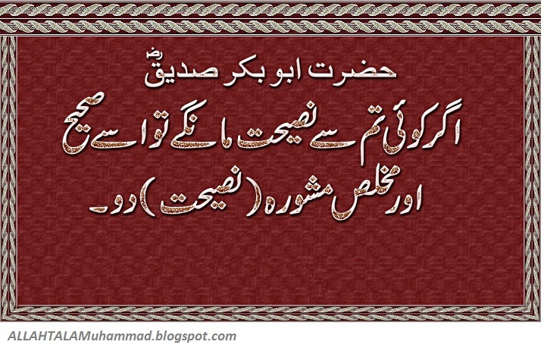

Slide 20
ASSIGNMENT OF ISLAMIC STUDIES
SUBMITTED BY NIDA YASMEEN

Slide 21
INTRODUCTION OF HAZRAT UMAR AL FAROOQ
Hazrat Umar Al- Farooq known as companion of the tomb he was second caliph of the rashidun khalifat. His father name was Khatab Ibn-e- Nafayl and his mother name was Hantamah Binti Hisham. He was born in Mecca Arabia on c. 583 CE and died on 3 November 644 CE. He belongs to a middle class family and he used to serve and take care of his father’s camels in the plains near Mecca. He was a senior sahabi of the Islamic prophet Muhammad. He succeeded Abu Bakar (632-634) as the second caliph of the rashidun caliphate on 23 august 634.

Slide 22
CONVERSION OF ISLAM
On his way met to his friend he told him about his own sister hazrat Fatima and her husband saeed bin zaid (umar’s cousin) had also accepted Islam. On hearing this news he was very angry and went straight to his sister’s house where he found her reading from the pages of Quran. Hazrat umar slapped his sister so hard that she fell down to the ground bleeding from her mouth. He begun beating his brother in law and his sister too got wounded in an attempt to protect her husband. Bleeding and bruised . He was a senior sahabi of the Islamic prophet Muhammad. He succeeded Abu Bakar (632-634) as the second caliph of the rashidun caliphate on 23 august 634. What was this faith that made even weak women so strong of heart? He asked his sister to show him what she had been reading: his sister replied in the negative and said you are unclean, and no unclean person can touch the scripture.’’ He forced, but his sister was not prepared to allow him to touch the pages unless he washed his body and then begun to read the verses. He was at once moved to the core by the words of the Quran and immediadely accept Islam.

Slide 23
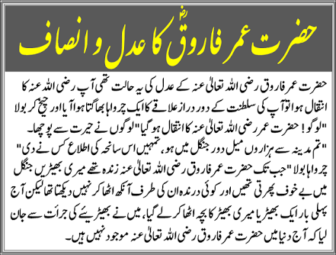

Slide 24
EASHA NAZIM
ISLAMIAT

Slide 25
HAZRAT USMAN GHANI

Slide 26
BIOGRAPHY:
Hazrat usman was born in 573 A.D in highly reputed family of umayyah.
Banu Umayyah enjoyed a great status among Qureyshi people as they had the responsibility of keeping the Flag of the whole clan.
His father was “Affan bin Abul-As” and his mother was known as “Arwa”. His complete name was “Usman ibn Affan”. His familial history also matched with that of the Holy Prophet ﷺ..

Slide 27
He started dealing in the business of cloth in his youth, which earned him a lot of wealth. He was greatly respected for his kind nature among the Makkans, as he used to help the poor and remove their troubles. That and later services to Islam in the form of spending his capital earned him the title of “Al-Ghani” (the Generous One). He was also well known for his truthfulness and honesty.

Slide 28
Acceptance of Islam:
Hazrat Abu Bakr (R.A) and he were close friends from the start. When the former told him about the Prophet Hood of Hazrat Muhammad ﷺ, he readily believed in it. This was because of his great insight of matters and clear conscious.
At that time, the relationships between Banu Hashim and Banu Umayyah had worsened, and when Hazrat Usman (R.A) accepted Islam, his own family and Qureyshi natives who loved him, started to hate him. But he did not care about himself, and stood firm on his decision.

Slide 29
Marrying Ruqayya (R.A) – the Daughter of Prophet PBUH:
After the preaching of Allah`s Message, the daughter of Rasulullah ﷺ, Ruqayya (R.A), who was married to Abu Lahb`s (a strict enemy of Islam) son Utbah at that time, was forcefully divorced. Then, Hazrat Usman (R.A) married her, which got him great honor of being the Son in Law of the Messenger ﷺ of God.

Slide 30
Emigration from Makkah to Abyssinia:
Hazrat Usman (R.A) made his firm belief in the Prophet Hood of Hazrat Muhammad ﷺ as public, he was not only detested by the disbelievers, but also was subjected to torture and physical sufferings. Therefore, he asked the permission of the Holy Prophet ﷺ of leaving Makkah, which was approved. Then, he and his wife along with some other Muslims migrated to Abyssinia and became the very first Muhajireen (leaving hometown for sake of Allah) in the history of Islam. That stay did not last long, as he came back to Makkah after short period of just two months when he was wrongly informed about Qureysh`s acceptance of the Religion of Peace.

Slide 31
Getting the title of “Dhun-Nurain” :
During the battle of “Badr”, Ruqayya (R.A) got seriously ill, which lead to Hazrat Usman`s (R.A) exclusion from this Ghazwa (clash in which the Prophet ﷺ participated Himself).
He remained in Madina to take care of her wife, who could not live longer and died. This gave him a great grief as was no longer the Son in Law of Rasulullah ﷺ. Upon this, the Apostle ﷺ of God married His other Daughter, Umm Kulthum (R.A) to Hazrat Usman (R.A). Thus He got the title of “Dhun-Nurain” (the possessor of the two lights) by having the great respect of marrying two of the daughters of the Holy Prophet ﷺ..

Slide 32
Great Services to Islam:
He served the Religion of Peace in many ways such as:
• Participated in nearly every battle against disbelievers along with Rasulullah ﷺ except in Badr
• Also purchased a portion of land in order to increase the capacity of Masjid e Nabawi.

Slide 33
• Helped in strengthening of the Muslim Army at the expedition of Tabuk by giving gold coins, horses and camels, which earned him the great respect of the Holy Prophet ﷺ, Who said:
“From this day on nothing will harm ‘Uthman regardless of what he does.” (Tirmidhi)
It means Rasulullah ﷺ had declared Hazrat Usman (R.A) as one the upright Muslims because of his selflessness and great service to Islam.

Slide 34
ASADULLAH
ISLAMIAT PRESENTATION

Slide 35
The prophet (P.B.U.H) said:
“Ali (A.S) is from me and I am from him and he is the protector of every true believer after me.

Slide 36
HAZRAT ALI (A.S)

Slide 37
BERIEF DETAILS:
NAME: ALI (A.S)
TITLE: ASADULLAH (LION OF ALLAH)
BIRTH: 13 RAJAB 21 B.H OR 15 SEP 601 AD
MOTHER: FATIMAH BINT ASAD
FATHER: ABU TALIB IBN ABD AL-MUTTALIB

Slide 38
BIRTH OF HAZRAT ALI
HAZRAT ALI WAS BORN IN HOLY KA’ABA.
FATIMA BINTE ASAD STAYED IN KA’ABA FOR 3 DAYS AND ON THE FOURTH DAY SHE STEPPED OUT WITH ALI(A.S).
“THE HOLY PROPHET (P.B.U.H) BROUGHT ME UP IN HIS ARMS AND FED ME FROM HIS OWN PLATE, I FOLLOWED HIM WHEREVER HE WENT LIKE A BABY CAMEL FOLLOWING ITS MOTHER”.
Hazrat Ali (A.S)

Slide 39
MARRIAGE:
UNDER DEVINE INSTRUCTIONS, THE APOSTLE OF ALLAH MARRIED HIS BELOVED DAUGHTER FATIMAH (R.A) TO ALI (A.S) THOUGH OTHERS VAINLY TRIED FOR HER HAND.
AMONG THEIR CHILDREN, IMAM HASSAN (A.S) AND IMAM HUSSAIN (A.S), ZAINAB AND UMM E KALTHUM LEFT THEIR MARKS ON THE HISTORY OF THE WORLD.

Slide 40
HIGHLIGHTS OF HIS LIFE
HE WAS THE FIRST TO ACCEPT ISLAM AMONG CHILDREN.
HE SLEPT IN THE BED OF PROPHET AT THE NIGHT OF MIGRATION.
AFTER MIGRATION, IT WAS ALI (A.S) THAT THE PROPHET TRUSTED HIM TO GIVE BACK ALL THE GUARDIANSHIPS (AMANATS) TO MAKKANS.

Slide 41
CONT: HIGHLIGHTS OF HIS LIFE
ROLE IN BATTLES.
IN ALL THE BATTLES ALI (A.S) WAS ALWAYS IN THE FOREFRONT.
BADR: FOUGHT AND KILLED MORE ENEMIES THAN ANYONE ELSE.
UHUD: PROTECTED THE PROPHET (P.B.U.H) WHILE OTHERS RAN AWAY IN FEAR.
KHANDAQ: KILLED AMR IBNE ABDE WAAS, THE STRONGEST ENEMY.

Slide 42
DEATH OF HAZRAT ALI A.S
HE WAS ATTACKED BY KHARIJITE ABD AL- RAHMAN IBN MULJAM ON19 Ramadan 40 AH, which would correspond to 27 January AD 661.
He was wounded by ibn Muljam's poison-coated sword while prostrating in the Fajr prayer.
Ali died two days later on 29 January AD 661 (21 Ramadan 40 A.H).

Slide 43


